Slide 1
Data Mining: Concepts and Techniques (3rd ed.) — Chapter 1 —
Jiawei Han, Micheline Kamber, and Jian Pei
University of Illinois at Urbana-Champaign &
Simon Fraser University
©2011 Han, Kamber & Pei. All rights reserved.
‹#›
‹#›
Notes:
‹#›
‹#›

Slide 2
Chapter 1. Introduction
Why Data Mining?
What Is Data Mining?
A Multi-Dimensional View of Data Mining
What Kind of Data Can Be Mined?
What Kinds of Patterns Can Be Mined?
What Technology Are Used?
What Kind of Applications Are Targeted?
Major Issues in Data Mining
A Brief History of Data Mining and Data Mining Society
Summary
‹#›
Notes:
‹#›

Slide 3
Why Data Mining?
The Explosive Growth of Data: from terabytes to petabytes
Data collection and data availability
Automated data collection tools, database systems, Web, computerized society
Major sources of abundant data
Business: Web, e-commerce, transactions, stocks, …
Science: Remote sensing, bioinformatics, scientific simulation, …
Society and everyone: news, digital cameras, YouTube
We are drowning in data, but starving for knowledge!
“Necessity is the mother of invention”—Data mining—Automated analysis of massive data sets
‹#›
Notes:
‹#›

Slide 4
Evolution of Sciences
1950s-1990s, computational science
Over the last 50 years, most disciplines have grown a third, computational branch (e.g. empirical, theoretical, and computational ecology, or physics, or linguistics.)
Computational Science traditionally meant simulation. It grew out of our inability to find closed-form solutions for complex mathematical models.
1990-now, data science
The flood of data from new scientific instruments and simulations
The ability to economically store and manage petabytes of data online
The Internet and computing Grid that makes all these archives universally accessible
Scientific info. management, acquisition, organization, query, and visualization tasks scale almost linearly with data volumes. Data mining is a major new challenge!
‹#›
Notes:
‹#›

Slide 5
Evolution of Database Technology
1960s:
Data collection, database creation, and network DBMS
1970s:
Relational data model, relational DBMS implementation
1980s:
RDBMS, advanced data models (extended-relational, OO, etc.)
Application-oriented DBMS (spatial, scientific, engineering, etc.)
1990s:
Data mining, data warehousing, multimedia databases, and Web databases
2000s
Stream data management and mining
Data mining and its applications
Web technology (XML, data integration) and global information systems
‹#›
Notes:
‹#›
Two slides should be added after this one
1. Evolution of machine learning
2. Evolution of statistics methods

Slide 6
Chapter 1. Introduction
Why Data Mining?
What Is Data Mining?
A Multi-Dimensional View of Data Mining
What Kind of Data Can Be Mined?
What Kinds of Patterns Can Be Mined?
What Technology Are Used?
What Kind of Applications Are Targeted?
Major Issues in Data Mining
A Brief History of Data Mining and Data Mining Society
Summary
‹#›
Notes:
‹#›

Slide 7


What Is Data Mining?
Data mining (knowledge discovery from data)
Extraction of interesting (non-trivial, implicit, previously unknown and potentially useful) patterns or knowledge from huge amount of data-[ShapiroandFrawley,2000;SaravananandVivekanandan,2004].
Data mining: Extracting the knowledge from large amount of data.
Alternative names
Knowledge discovery (mining) in databases (KDD), knowledge extraction, data/pattern analysis, data archeology, data dredging, information harvesting, business intelligence, etc.
Watch out: Is everything “data mining”?
Simple search and query processing
‹#›
Notes:
‹#›

Slide 8
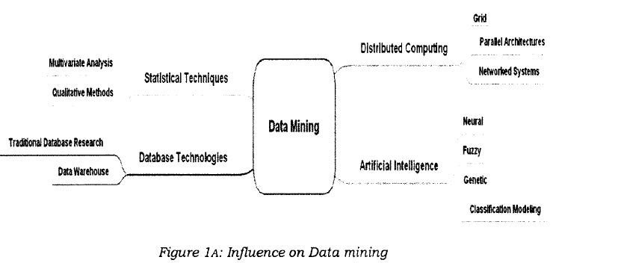
*
Data Mining: Concepts and Techniques
‹#›

Slide 9
Knowledge Discovery (KDD) Process
Knowledge
This is a view from typical database systems and data warehousing communities
Data mining plays an essential role in the knowledge discovery process
Pattern Evaluation
Data Mining
Task-relevant Data
Data Warehouse
Selection
Data Cleaning
Data Integration
Databases
‹#›
Notes:
‹#›

Slide 10
Example: A Web Mining Framework
Web mining usually involves
Data cleaning
Data integration from multiple sources
Warehousing the data
Data cube construction
Data selection for data mining
Data mining
Presentation of the mining results
Patterns and knowledge to be used or stored into knowledge-base
‹#›
Notes:
‹#›

Slide 11
Data Mining in Business Intelligence
Increasing potential
to support
business decisions
End User
Decision Making
Data Presentation
Business
Analyst
Visualization Techniques
Data Mining
Data
Analyst
Information Discovery
Data Exploration
Statistical Summary, Querying, and Reporting
Data Preprocessing/Integration, Data Warehouses
Data Sources
DBA
Paper, Files, Web documents, Scientific experiments, Database Systems
‹#›
Notes:
‹#›

Slide 12
KDD Process: A Typical View from ML and Statistics
Pattern Information Knowledge
Input Data
Data Pre-Processing
Data Mining
Post-Processing
Data integration
Normalization
Feature selection
Dimension reduction
Pattern discovery
Association & correlation
Classification
Clustering
Outlier analysis
… … … …
Pattern evaluation
Pattern selection
Pattern interpretation
Pattern visualization
This is a view from typical machine learning and statistics communities
‹#›
Notes:
‹#›

Slide 13
Example: Medical Data Mining
Health care & medical data mining – often adopted such a view in statistics and machine learning
Preprocessing of the data (including feature extraction and dimension reduction)
Classification or/and clustering processes
Post-processing for presentation
‹#›
Notes:
‹#›

Slide 14
Chapter 1. Introduction
Why Data Mining?
What Is Data Mining?
A Multi-Dimensional View of Data Mining
What Kind of Data Can Be Mined?
What Kinds of Patterns Can Be Mined?
What Technology Are Used?
What Kind of Applications Are Targeted?
Major Issues in Data Mining
A Brief History of Data Mining and Data Mining Society
Summary
‹#›
Notes:
‹#›

Slide 15
Multi-Dimensional View of Data Mining
Data to be mined
Database data (extended-relational, object-oriented, heterogeneous, legacy), data warehouse, transactional data, stream, spatiotemporal, time-series, sequence, text and web, multi-media, graphs & social and information networks
Knowledge to be mined (or: Data mining functions)
Characterization, discrimination, association, classification, clustering, trend/deviation, outlier analysis, etc.
Descriptive vs. predictive data mining
Multiple/integrated functions and mining at multiple levels
Techniques utilized
Data-intensive, data warehouse (OLAP), machine learning, statistics, pattern recognition, visualization, high-performance, etc.
Applications adapted
Retail, telecommunication, banking, fraud analysis, bio-data mining, stock market analysis, text mining, Web mining, etc.
‹#›
Notes:
‹#›

Slide 16
Chapter 1. Introduction
Why Data Mining?
What Is Data Mining?
A Multi-Dimensional View of Data Mining
What Kind of Data Can Be Mined?
What Kinds of Patterns Can Be Mined?
What Technology Are Used?
What Kind of Applications Are Targeted?
Major Issues in Data Mining
A Brief History of Data Mining and Data Mining Society
Summary
‹#›
Notes:
‹#›

Slide 17
Data Mining: On What Kinds of Data?
Database-oriented data sets and applications
Relational database, data warehouse, transactional database
Advanced data sets and advanced applications
Data streams and sensor data
Time-series data, temporal data, sequence data (incl. bio-sequences)
Structure data, graphs, social networks and multi-linked data
Object-relational databases
Heterogeneous databases and legacy databases
Spatial data and spatiotemporal data
Multimedia database
Text databases
The World-Wide Web
‹#›
Notes:
‹#›

Slide 18
Chapter 1. Introduction
Why Data Mining?
What Is Data Mining?
A Multi-Dimensional View of Data Mining
What Kind of Data Can Be Mined?
What Kinds of Patterns Can Be Mined?
What Technology Are Used?
What Kind of Applications Are Targeted?
Major Issues in Data Mining
A Brief History of Data Mining and Data Mining Society
Summary
‹#›
Notes:
‹#›

Slide 19
Data Mining Function: (1) Generalization
Information integration and data warehouse construction
Data cleaning, transformation, integration, and multidimensional data model
Data cube technology
Scalable methods for computing (i.e., materializing) multidimensional aggregates
OLAP (online analytical processing)
Multidimensional concept description: Characterization and discrimination
Generalize, summarize, and contrast data characteristics, e.g., dry vs. wet region
‹#›
Notes:
‹#›
I BELIEVE WE MAY NEED TO DO IT IN MORE IN-DEPTH INTRODUCTION, USING SOME EXAMPLES. So it will take one slide for one function, i.e., one chapter we want to cover. Do we need to cover chapter 2: preprocessing and 3. Statistical methods?

Slide 20
Data Mining Function: (2) Association and Correlation Analysis
Frequent patterns (or frequent itemsets)
What items are frequently purchased together in your Walmart/Dmart?
Association, correlation vs. causality
A typical association rule
Diaper 🡪 Beer [0.5%, 75%] (support, confidence)
Are strongly associated items also strongly correlated?
How to mine such patterns and rules efficiently in large datasets?
How to use such patterns for classification, clustering, and other applications?
‹#›
Notes:
‹#›

Slide 21
Data Mining Function: (3) Classification
Classification and label prediction
Construct models (functions) based on some training examples
Describe and distinguish classes or concepts for future prediction
E.g., classify countries based on (climate), or classify cars based on (gas mileage)
Predict some unknown class labels
Typical methods
Decision trees, naïve Bayesian classification, support vector machines, neural networks, rule-based classification, pattern-based classification, logistic regression, …
Typical applications:
Credit card fraud detection, direct marketing, classifying stars, diseases, web-pages, …
‹#›
Notes:
‹#›

Slide 22
Data Mining Function: (4) Cluster Analysis
Unsupervised learning (i.e., Class label is unknown)
Group data to form new categories (i.e., clusters), e.g., cluster houses to find distribution patterns
Principle: Maximizing intra-class similarity & minimizing interclass similarity
Many methods and applications
‹#›
Notes:
‹#›

Slide 23
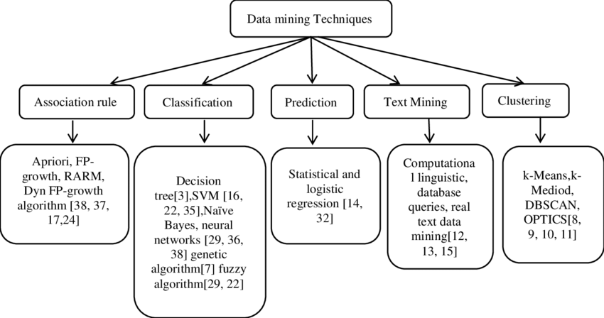
*
Data Mining: Concepts and Techniques
‹#›

Slide 24
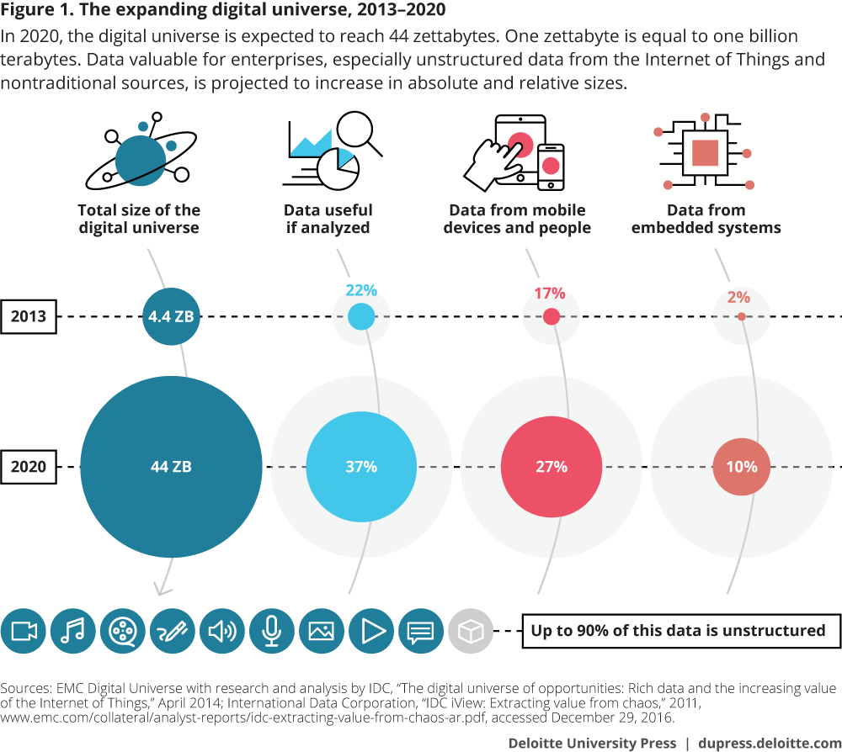
*
Data Mining: Concepts and Techniques
‹#›

Slide 25
Difference between ML and DM
basic for comparison | Data mining | Machine learning
Meaning | Extracting knowledge from a large amount of data | Introduce new algorithm from data as well as past experience
History | Introduce in 1930, initially referred as knowledge discovery in databases | introduce in near 1950, the first program was Samuel’s checker-playing program
Responsibility | Data mining is used to get the rules from the existing data. | Machine learning teaches the computer to learn and understand the given rules.
Origin | Traditional databases with unstructured data | Existing data as well as algorithms.
*
Data Mining: Concepts and Techniques
‹#›

Slide 26
Difference between ML and DM
basic for comparison | Data mining | Machine learning
Implementation | We can develop our own models where we can use data mining techniques for | We can use machine learning algorithm in the decision tree, neural networks and some other area of artificial intelligence.
Nature | Involves human interference more towards manual. | Automated, once design self-implemented, no human effort
Application | used in cluster analysis | used in web search, spam filter, credit scoring, fraud detection, computer design
*
Data Mining: Concepts and Techniques
‹#›

Slide 27
Difference between Big data analytics and DM
Feature | Data Mining | Big Data
Focus | It mainly focusses on lots of details of a data | It mainly focusses on lots of relationships between data
View | It is a close-up view of data | It is the Big Picture of data
Data | It expresses what about the data | It expresses Why of the data
Volume | It can be used for small data or big data | It refers to a large amount of data sets
Definition | It is a technique for analyzing data | It is a concept than a precise term
Data Types | Structured data, relational and dimensional database. | Structured, Semi-Structured and Unstructured data (in NoSQL)
Analysis | Mainly Statistical Analysis, focus on prediction and discovery of business factors on small scale. | Mainly data analysis, focus on prediction and discovery of business factors on large scale.
Results | Mainly for strategic decision making | Dashboards and predictive measures
*
Data Mining: Concepts and Techniques
‹#›

Slide 28
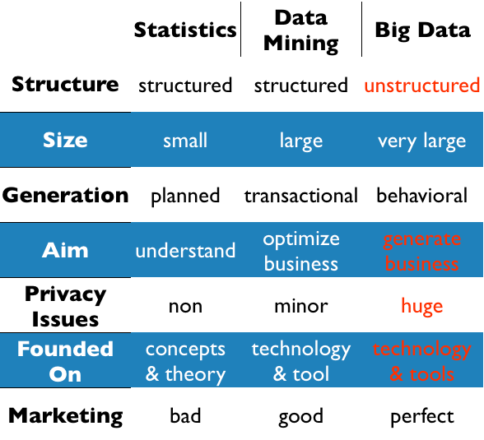
*
Data Mining: Concepts and Techniques
‹#›

Slide 29
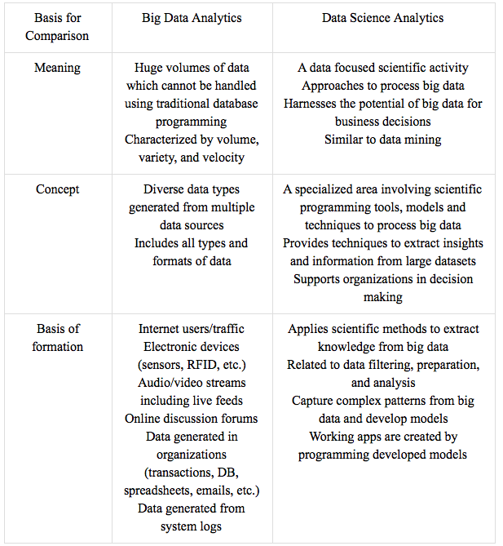
*
Data Mining: Concepts and Techniques
‹#›

Slide 30
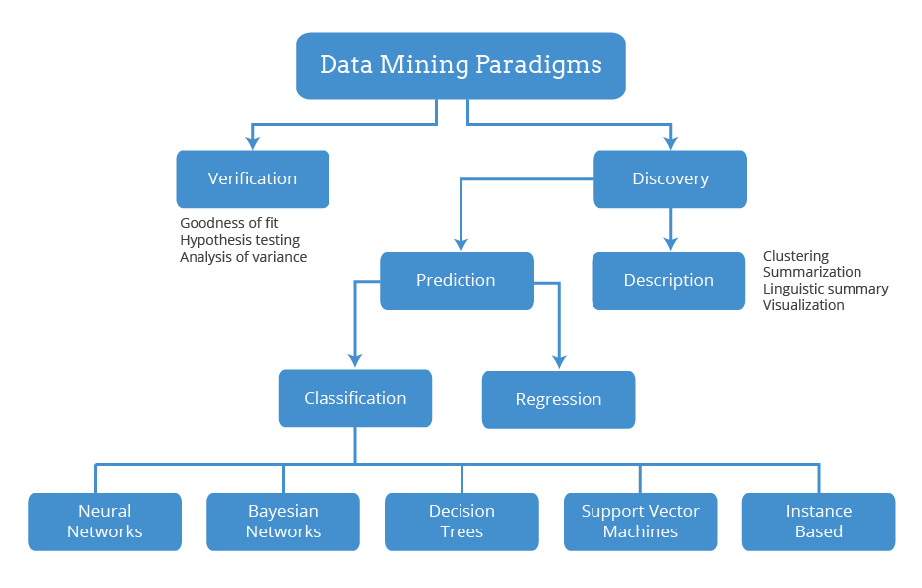
*
Data Mining: Concepts and Techniques
‹#›

Slide 31
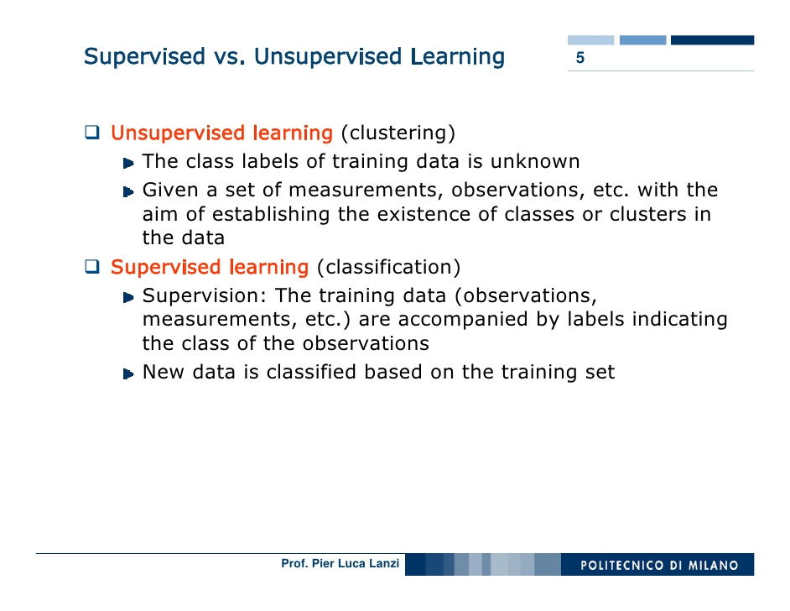
*
Data Mining: Concepts and Techniques
‹#›

Slide 32
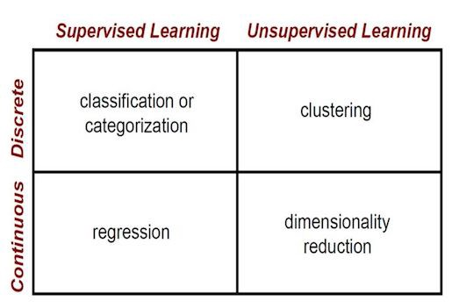
Ex. 4 possible values- categorical, discrete
Infinite possible values- continuous
*
Data Mining: Concepts and Techniques
‹#›

Slide 33
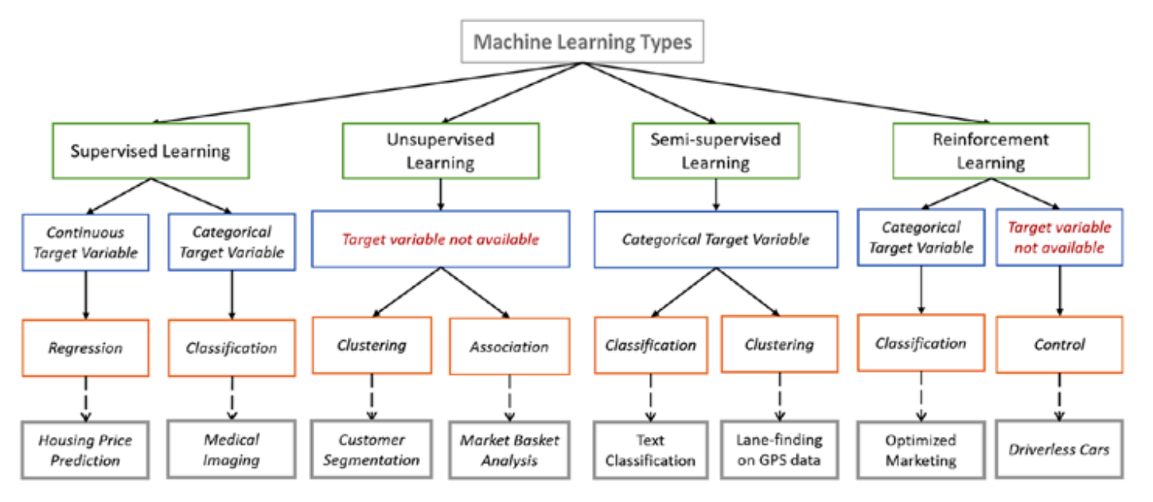
*
Data Mining: Concepts and Techniques
‹#›

Slide 34
Data Mining Function: (5) Outlier Analysis
Outlier analysis
Outlier: A data object that does not comply with the general behavior of the data
Noise or exception? ― One person’s garbage could be another person’s treasure
Methods: by product of clustering or regression analysis, …
Useful in fraud detection, rare events analysis
‹#›
Notes:
‹#›

Slide 35
Time and Ordering: Sequential Pattern, Trend and Evolution Analysis
Sequence, trend and evolution analysis
Trend, time-series, and deviation analysis: e.g., regression and value prediction
Sequential pattern mining
e.g., first buy digital camera, then buy large SD memory cards
Periodicity analysis
pattern and biological sequence analysis
Approximate and consecutive pattern
Similarity-based analysis
Mining data streams
Ordered, time-varying, potentially infinite, data streams
‹#›
Notes:
‹#›

Slide 36
Structure and Network Analysis
Graph mining
Finding frequent subgraphs (e.g., chemical compounds), trees (XML), substructures (web fragments)
Information network analysis
Social networks: actors (objects, nodes) and relationships (edges)
e.g., author networks in CS, terrorist networks
Multiple heterogeneous networks
A person could be multiple information networks: friends, family, classmates, …
Links carry a lot of semantic information: Link mining-
Web mining
Web is a big information network: from PageRank to Google
Analysis of Web information networks
Web community discovery, opinion mining, usage mining, …
‹#›
Notes:
‹#›
This chapter will not be in the new version, will it?
BUT SHOULD WESTILL INTRODCE THEM SO THAT THEY WILL GET AN OVERALL PICTURE?

Slide 37
Evaluation of Knowledge
Are all mined knowledge interesting?
One can mine tremendous amount of “patterns” and knowledge
Some may fit only certain dimension space (time, location, …)
Some may not be representative, may be transient, …
Evaluation of mined knowledge → directly mine only interesting knowledge?
Descriptive vs. predictive
Coverage
Typicality vs. novelty
Accuracy
Timeliness
…
‹#›
Notes:
‹#›

Slide 38
Chapter 1. Introduction
Why Data Mining?
What Is Data Mining?
A Multi-Dimensional View of Data Mining
What Kind of Data Can Be Mined?
What Kinds of Patterns Can Be Mined?
What Technology Are Used?
What Kind of Applications Are Targeted?
Major Issues in Data Mining
A Brief History of Data Mining and Data Mining Society
Summary
‹#›
Notes:
‹#›

Slide 39
Data Mining: Confluence of Multiple Disciplines
Machine
Learning
Pattern
Recognition
Statistics
Applications
Data Mining
Visualization
Algorithm
Database
Technology
High-Performance
Computing
‹#›
Notes:
‹#›

Slide 40
Why Confluence of Multiple Disciplines?
Tremendous amount of data
Algorithms must be highly scalable to handle such as tera-bytes of data
High-dimensionality of data
Micro-array may have tens of thousands of dimensions
High complexity of data
Data streams and sensor data
Time-series data, temporal data, sequence data
Structure data, graphs, social networks and multi-linked data
Heterogeneous databases and legacy databases
Spatial, spatiotemporal, multimedia, text and Web data
Software programs, scientific simulations
New and sophisticated applications
‹#›
Notes:
‹#›
Add a definition/description of “traditional data analysis”.

Slide 41
Chapter 1. Introduction
Why Data Mining?
What Is Data Mining?
A Multi-Dimensional View of Data Mining
What Kind of Data Can Be Mined?
What Kinds of Patterns Can Be Mined?
What Technology Are Used?
What Kind of Applications Are Targeted?
Major Issues in Data Mining
A Brief History of Data Mining and Data Mining Society
Summary
‹#›
Notes:
‹#›

Slide 42
Applications of Data Mining
Web page analysis: from web page classification, clustering to PageRank & HITS algorithms
Collaborative analysis & recommender systems
Basket data analysis to targeted marketing
Biological and medical data analysis: classification, cluster analysis (microarray data analysis), biological sequence analysis, biological network analysis
Data mining and software engineering
From major dedicated data mining systems/tools (e.g., SAS, MS SQL-Server Analysis Manager, Oracle Data Mining Tools) to invisible data mining
‹#›
Notes:
‹#›

Slide 43
Chapter 1. Introduction
Why Data Mining?
What Is Data Mining?
A Multi-Dimensional View of Data Mining
What Kind of Data Can Be Mined?
What Kinds of Patterns Can Be Mined?
What Technology Are Used?
What Kind of Applications Are Targeted?
Major Issues in Data Mining
A Brief History of Data Mining and Data Mining Society
Summary
‹#›
Notes:
‹#›

Slide 44
Major Issues in Data Mining (1)
Mining Methodology
Mining various and new kinds of knowledge
Mining knowledge in multi-dimensional space
Data mining: An interdisciplinary effort
Boosting the power of discovery in a networked environment
Handling noise, uncertainty, and incompleteness of data
Pattern evaluation and pattern- or constraint-guided mining
User Interaction
Interactive mining
Incorporation of background knowledge
Presentation and visualization of data mining results
‹#›
Notes:
‹#›

Slide 45
Major Issues in Data Mining (2)
Efficiency and Scalability
Efficiency and scalability of data mining algorithms
Parallel, distributed, stream, and incremental mining methods
Diversity of data types
Handling complex types of data
Mining dynamic, networked, and global data repositories
Data mining and society
Social impacts of data mining
Privacy-preserving data mining
Invisible data mining
‹#›
Notes:
‹#›

Slide 46
Chapter 1. Introduction
Why Data Mining?
What Is Data Mining?
A Multi-Dimensional View of Data Mining
What Kind of Data Can Be Mined?
What Kinds of Patterns Can Be Mined?
What Technology Are Used?
What Kind of Applications Are Targeted?
Major Issues in Data Mining
A Brief History of Data Mining and Data Mining Society
Summary
‹#›
Notes:
‹#›

Slide 47
A Brief History of Data Mining Society
1989 IJCAI Workshop on Knowledge Discovery in Databases
Knowledge Discovery in Databases (G. Piatetsky-Shapiro and W. Frawley, 1991)
1991-1994 Workshops on Knowledge Discovery in Databases
Advances in Knowledge Discovery and Data Mining (U. Fayyad, G. Piatetsky-Shapiro, P. Smyth, and R. Uthurusamy, 1996)
1995-1998 International Conferences on Knowledge Discovery in Databases and Data Mining (KDD’95-98)
Journal of Data Mining and Knowledge Discovery (1997)
ACM SIGKDD conferences since 1998 and SIGKDD Explorations
More conferences on data mining
PAKDD (1997), PKDD (1997), SIAM-Data Mining (2001), (IEEE) ICDM (2001), etc.
ACM Transactions on KDD starting in 2007
‹#›
Notes:
‹#›

Slide 48
Conferences and Journals on Data Mining
KDD Conferences
ACM SIGKDD Int. Conf. on Knowledge Discovery in Databases and Data Mining (KDD)
SIAM Data Mining Conf. (SDM)
(IEEE) Int. Conf. on Data Mining (ICDM)
European Conf. on Machine Learning and Principles and practices of Knowledge Discovery and Data Mining (ECML-PKDD)
Pacific-Asia Conf. on Knowledge Discovery and Data Mining (PAKDD)
Int. Conf. on Web Search and Data Mining (WSDM)
Other related conferences
DB conferences: ACM SIGMOD, VLDB, ICDE, EDBT, ICDT, …
Web and IR conferences: WWW, SIGIR, WSDM
ML conferences: ICML, NIPS
PR conferences: CVPR,
Journals
Data Mining and Knowledge Discovery (DAMI or DMKD)
IEEE Trans. On Knowledge and Data Eng. (TKDE)
KDD Explorations
ACM Trans. on KDD
‹#›
Notes:
‹#›

Slide 49
Where to Find References? DBLP, CiteSeer, Google
Data mining and KDD (SIGKDD: CDROM)
Conferences: ACM-SIGKDD, IEEE-ICDM, SIAM-DM, PKDD, PAKDD, etc.
Journal: Data Mining and Knowledge Discovery, KDD Explorations, ACM TKDD
Database systems (SIGMOD: ACM SIGMOD Anthology—CD ROM)
Conferences: ACM-SIGMOD, ACM-PODS, VLDB, IEEE-ICDE, EDBT, ICDT, DASFAA
Journals: IEEE-TKDE, ACM-TODS/TOIS, JIIS, J. ACM, VLDB J., Info. Sys., etc.
AI & Machine Learning
Conferences: Machine learning (ML), AAAI, IJCAI, COLT (Learning Theory), CVPR, NIPS, etc.
Journals: Machine Learning, Artificial Intelligence, Knowledge and Information Systems, IEEE-PAMI, etc.
Web and IR
Conferences: SIGIR, WWW, CIKM, etc.
Journals: WWW: Internet and Web Information Systems,
Statistics
Conferences: Joint Stat. Meeting, etc.
Journals: Annals of statistics, etc.
Visualization
Conference proceedings: CHI, ACM-SIGGraph, etc.
Journals: IEEE Trans. visualization and computer graphics, etc.
‹#›
Notes:
‹#›

Slide 50
Chapter 1. Introduction
Why Data Mining?
What Is Data Mining?
A Multi-Dimensional View of Data Mining
What Kind of Data Can Be Mined?
What Kinds of Patterns Can Be Mined?
What Technology Are Used?
What Kind of Applications Are Targeted?
Major Issues in Data Mining
A Brief History of Data Mining and Data Mining Society
Summary
‹#›
Notes:
‹#›

Slide 51
Summary
Data mining: Discovering interesting patterns and knowledge from massive amount of data
A natural evolution of database technology, in great demand, with wide applications
A KDD process includes data cleaning, data integration, data selection, transformation, data mining, pattern evaluation, and knowledge presentation
Mining can be performed in a variety of data
Data mining functionalities: characterization, discrimination, association, classification, clustering, outlier and trend analysis, etc.
Data mining technologies and applications
Major issues in data mining
‹#›
Notes:
‹#›

Slide 52
Recommended Reference Books
S. Chakrabarti. Mining the Web: Statistical Analysis of Hypertex and Semi-Structured Data. Morgan Kaufmann, 2002
R. O. Duda, P. E. Hart, and D. G. Stork, Pattern Classification, 2ed., Wiley-Interscience, 2000
T. Dasu and T. Johnson. Exploratory Data Mining and Data Cleaning. John Wiley & Sons, 2003
U. M. Fayyad, G. Piatetsky-Shapiro, P. Smyth, and R. Uthurusamy. Advances in Knowledge Discovery and Data Mining. AAAI/MIT Press, 1996
U. Fayyad, G. Grinstein, and A. Wierse, Information Visualization in Data Mining and Knowledge Discovery, Morgan Kaufmann, 2001
J. Han and M. Kamber. Data Mining: Concepts and Techniques. Morgan Kaufmann, 3rd ed., 2011
D. J. Hand, H. Mannila, and P. Smyth, Principles of Data Mining, MIT Press, 2001
T. Hastie, R. Tibshirani, and J. Friedman, The Elements of Statistical Learning: Data Mining, Inference, and Prediction, 2nd ed., Springer-Verlag, 2009
B. Liu, Web Data Mining, Springer 2006.
T. M. Mitchell, Machine Learning, McGraw Hill, 1997
G. Piatetsky-Shapiro and W. J. Frawley. Knowledge Discovery in Databases. AAAI/MIT Press, 1991
P.-N. Tan, M. Steinbach and V. Kumar, Introduction to Data Mining, Wiley, 2005
S. M. Weiss and N. Indurkhya, Predictive Data Mining, Morgan Kaufmann, 1998
I. H. Witten and E. Frank, Data Mining: Practical Machine Learning Tools and Techniques with Java Implementations, Morgan Kaufmann, 2nd ed. 2005
‹#›
Notes:
‹#›

Slide 53
Example: Mining vs. Data Exploration
Business intelligence view
Warehouse, data cube, reporting but not much mining
Business objects vs. data mining tools
Supply chain example: tools
Data presentation
Exploration
‹#›
Notes:
‹#›

